Slide 1

NHH · 2026
Schedule-Free Autonomous Boats in Bergen
A reinforcement learning approach

Slide 2
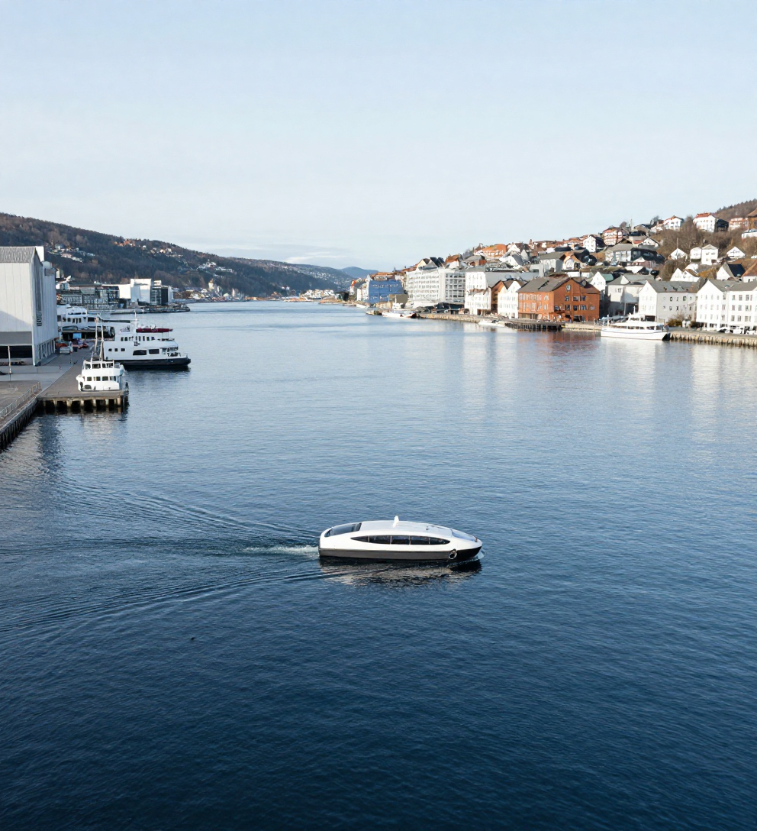
The
Idea
• On-demand autonomous boats in Bergen — no fixed schedule
• Passengers state: origin, destination, and desired arrival time
• The system decides, in real time, how boats move to serve them
• Goal: get people close to their desired arrival time, efficiently

Slide 3

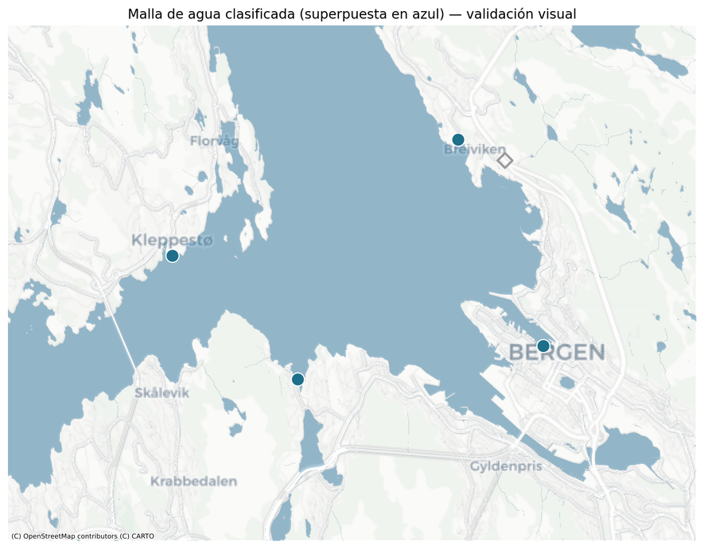
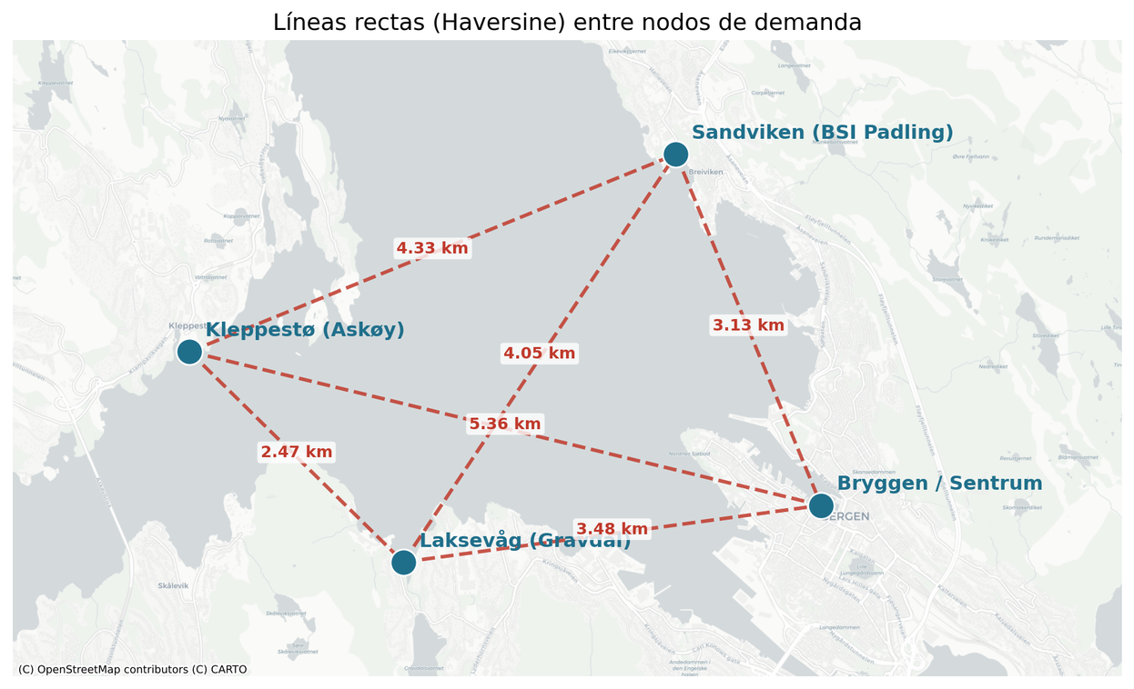
Bergen Boats · Page 3
What's done: navigable routing
Realistic travel times
Straight lines cross land

Slide 4
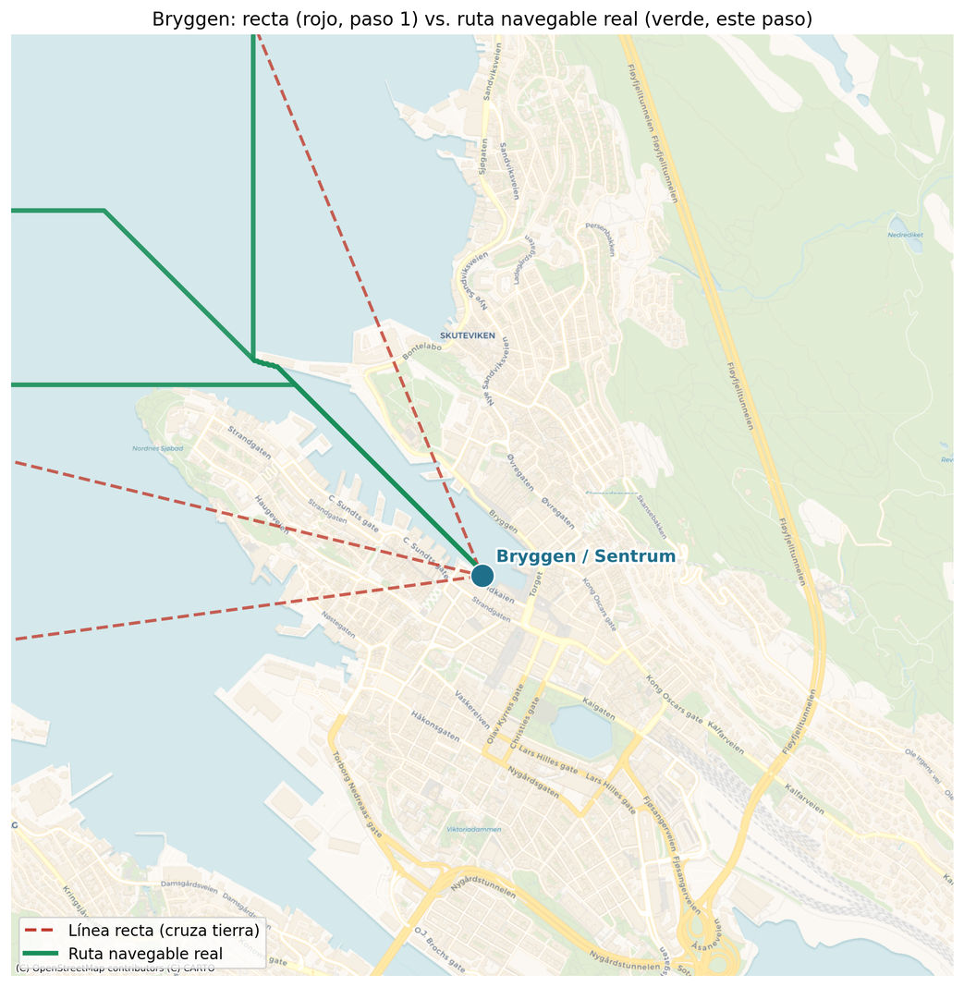
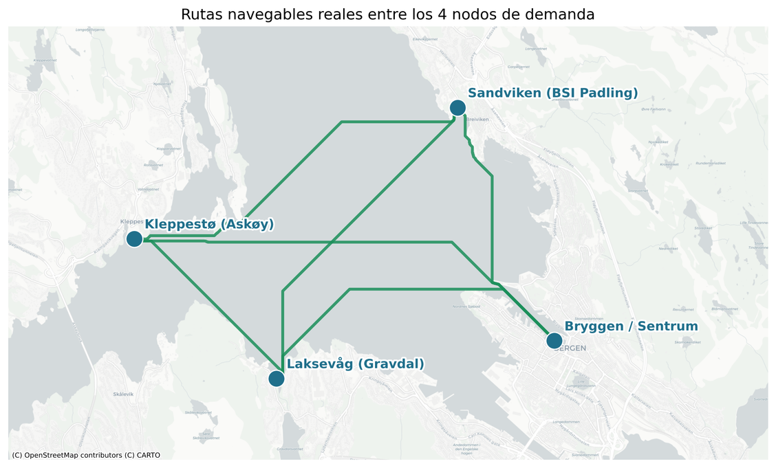
What's done: navigable routing
Water mask + Dijkstra = shortest path on water

Slide 5

Building on
Gu & Wallace (2021)
Static model: optimal location, fleet size, and routing for autonomous boats. Foundation of the Bergen case.
01
the group's models
Braathen, Goez & Guajardo (2024)
Static weekly routes pre-computed. Exact model did not scale to larger instances or real-time demand.
02
This thesis: learning-based, dynamic
Real-time, learning-based operation. An RL agent fills the gap left open by prior models.

Slide 6
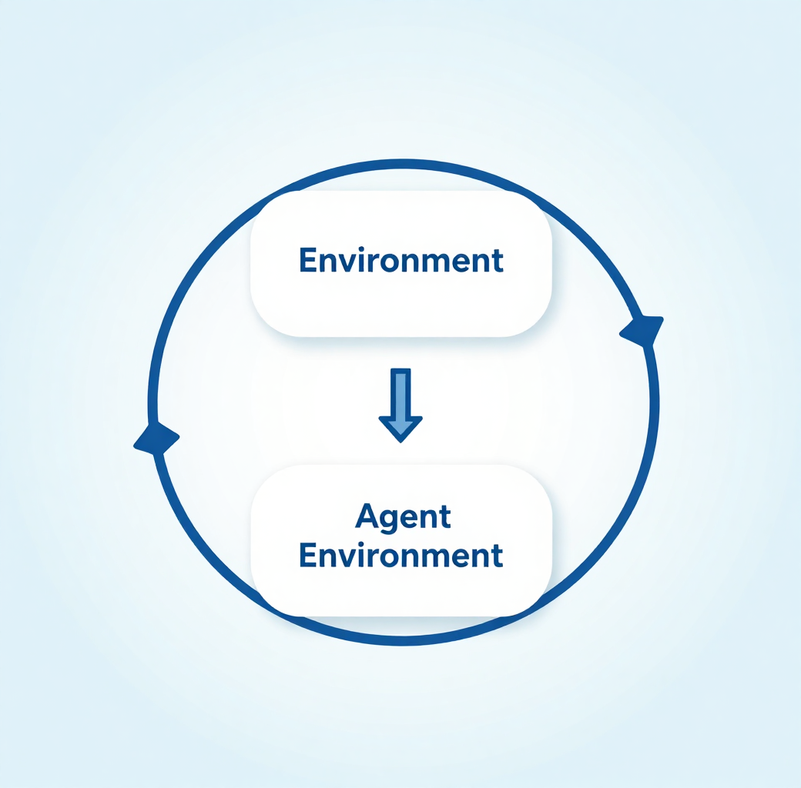
What reinforcement learning is
Learning by trial and error
An agent takes actions in an environment
Good outcome : reward - bad outcome : penalty
It adjusts, repeats thousands of times : learns a policy
Like learning to ride a bike

Slide 7
From an ideal
assumption to a learning agent
• Ideal assumption: perfect demand info the moment a trip is requested
– State: boat positions + waiting demand + expected pattern
– Action: where each boat goes next (or wait)
– Reward: penalize arrival-time deviation & lost demand
• An agent learns a policy by trial and error in a simulator
The agent iterates over thousands of simulated weeks - improving its policy each time until it learns to serve demand efficiently.

Slide 8
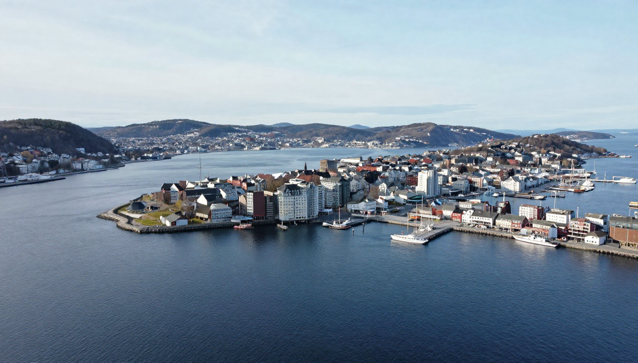
Thank You

Slide 9
The problem
Passengers appear
origin, destination,
over time (Poisson)
System decides
which boat goes where,
in real time
People are served
or leave if they
wait too long
Sequential decisions, under uncertainty
each choice affects the next - we don't know who requests a trip next
The problem has a formal structure: a Markov Decision Process (MDP). And the method to solve an MDP is reinforcement learning.

Slide 10
From problem to method
My problem
real-time boat dispatch
MDP
the formal description
(the "what")
Reinforcement learning
the method to solve it
(the "how")
describe
solve
The problem has a formal structure: a Markov Decision Process (MDP). And the method to solve an MDP is reinforcement learning.

Slide 11
Markov property.
Markov property: the future depends only on the current state, not on the path taken. Markovian by design: the state holds everything needed to decide, including time of day.

Slide 12
How RL solves it: the Bellman equation
Q(s,a) ← Q(s,a) + α · [ r + γ · maxQ(s',a') − Q(s,a) ]
Q(s, a)
how good I think this action is in this state
α (learning rate)
size of each adjustment (≈ 0.0001–0.001)
r
the real reward I got (what actually happened)
γ · maxQ(s', a')
best possible future from the new state, discounted
The bracket [ … ] is the ERROR
difference between what I expected and what really happened → I nudge my estimate that way.
In deep RL, I adjust a network instead of a table. (Loss = ( target − predicción )² = ( [r + γ·maxQ(s',a')] − Q_red(s,a) )²)
Repeat millions of times - the policy converges to the optimal one
Notes:
1. Value-Based Loss (Temporal Difference Error)
In value-based methods (like Q-learning or DQN), the model predicts the expected future reward for a state-action pair, written as Q(S, A). [1]
The Bellman Target: The target value combines the immediate reward (R) and the discounted maximum future value (γ Q(S', A')).
The Error Formula: The difference between the target and the current prediction is the Temporal Difference (TD) error:
\(\delta =R+\gamma Q(S^{\prime },A^{\prime })-Q(S,A)\)
The Loss Function: Squaring this error creates a standard mean squared error loss function:
\(L(W)=[R+\gamma Q(S^{\prime },A^{\prime })-Q(S,A)]^{2}\)

Slide 13
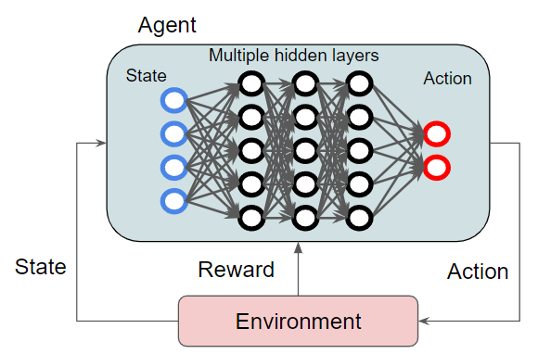
Tabular vs deep
n small problems that Q lives in a table. But my state space is enormous (every combination of boat positions and waiting groups. No table fits it. So I replace the table with a neural network that approximates Q and generalizes to states it hasn't seen. Same Bellman logic) greater reach. That's deep Q-learning.

Slide 14
The training loop
Agent
the policy / neural net
decides which boat goes where
action: "boat 1 → Kleppestø"
Environment = simulator
boats, demand, times
this is the MDP transition
state + reward: new snapshot + score
Repeat thousands of times
the policy improves each loop
The agent observes state, picks an action; the environment (my simulator) returns the new state and reward; the agent adjusts. The simulator is a required piece. The agent learns by trial and error and needs a world to practice in.
PyTorch library for deep, Para el entrenamiento de rl ya existe Stable-Baselines3 solo es conectar el simulador y ella se entrena. El simulador lo construimos con la interfas estándar de Gymnasium

Slide 15
State (tres bloques)
Boats
For every boat: dónde está (en qué nodo, o si va navegando, hacia dónde y cuánto le falta para llegar), y cuántos lugares libres tiene.
posición, destino si se mueve, minutos para llegar, ocupación.
Demant
Por par origen destino: cuanta gente espera y hace cuanto (grupos ☹ no se como mirarlos)
Time
Hora y dia de la semana

Slide 16
State (tres bloques)
Boats
For every boat: dónde está (en qué nodo, o si va navegando, hacia dónde y cuánto le falta para llegar), y cuántos lugares libres tiene.
posición, destino si se mueve, minutos para llegar, ocupación, esta libre?.
estado = {
"barcos": [
# Barco 0: quieto en Bryggen, vacío, sin pasajeros
{ "origen": "B", "destino": "B", "min_para_llegar": 0, "ocupacion": 0, "libre": true },
# Barco 1: a media ruta de Kleppestø a Bryggen, con 12 personas, le faltan 6 min
{ "origen": "K", "destino": "B", "min_para_llegar": 6, "ocupacion": 12, "libre": false }
],
"demanda_esperando": {
# por cada par origen-destino: cuánta gente y hace cuánto espera el más antiguo
"K->B": { "personas": 15, "espera_max_min": 8 },
"K->S": { "personas": 3, "espera_max_min": 2 },
"L->B": { "personas": 0, "espera_max_min": 0 },
... (los 12 pares)
}
"tiempo": { "minuto_del_dia": 465, “dia": “lunes" }
}
(id, tamaño, tiempo de llegada, destino)

Slide 17
Action (se despertaria cuando un barco llegue)
Yo quiero que también se despierte cuando llega un nuevo grupo y pueda redirigir barcos, o mantenerlos como están. (Se agranda el modelo).
O manejarlo no por eventos si no por tiempo, cada 2 min que se envie
Boats
Para un barco disponible (uno que está libre en un nodo, o que acaba de terminar un viaje), la acción es elegir a qué nodo ir a continuación, o quedarse esperando.
Demant (I would like)
Decida a quien recoger = "ir a K y recoger el grupo tal".
How Many Boats to usu (I would like)
Espero que con la penalizacon se cumpla usar la menor cantidad, Tambien podria crear una penalizcion de estar encendido el barco.
accion = {
"barco_0": "ir_a_K", # manda el barco 0 a Kleppestø
"barco_1": "seguir" # el barco 1 sigue su ruta actual (no se toca)
}

Slide 18
Reward design
Excess = total time(wait+travel) − ideal direct time
total time = waiting to be picked up + travelling (incl. detours). If you go straight with no wait, excess = 0.
Penalty per passenger = (exceso / 10)²
penalización_pasajero = (exceso / 10)² - 10 como minutos razonables donde ya empieza a ser molesta la espera (esto a modo de normalizer y dejar eso penalidad en valores mas cortos, tipo exceso de 20 min = 4)
sobrante = máximo(0, T − 12)
sobrante²
Large penalty: lost group
patience runs out (15/30 min), leaves by bus --- penalización_perdido = 10 × (personas en el grupo / tamaño_medio)
Small penalty: boat move
discourages pointless repositioning ------ 0.1 por barco en movimiento (Espero evitar que haga rutas innesesarias y ademas que no muevo muchos botes si no es necesario, osea deje apagados algunos)
reward per step = − Σ(exceso/10)² − Σ 10×(personas/media) por perdido − 0.1 × movimientos
Why quadratic leads where we want
keeps everyone reasonably well rather than a few perfect and many terrible → fair, direct-as-possible service

Slide 19
Reward design
Restricciones:
1. barco solo puede subir a grupos que esten en su capacidad (Los grupos son indivisibles)
Decisiones
1. Cantidad de flojas, fijas ? Voy cambiandolo en cada corrida y viendo su mejora.
2. Penalizo por cada barco active ? Buscadno que si no lo necesita no lo use.

Slide 20
Simulador
Tiempos de transiscion + 1 min de cada parada (esto de hacer paradas como va sumando en el tiempo se penaliza en el excess
Lo manejamos por grupos o iniciamos hacienodlo solo por personas individual, lo de grupo lo tomamos del paiper y porque si sabemos que computacional mente sera super demandante individual pero es algo que no se ha probado, vale la pena dejar grupos desde ya ?

Slide 21
Simulation environment: the MDP
State
boat positions and occupancy, passengers waiting per pair, time of day
Action
for each boat, go to one of the four points, or wait (no mid-route change)
Transition
the simulator, boats move on real times, demand arrives, 2-minute steps
Reward
penalises time in the system and inefficient movement
Discount
gamma = 0.99, high, so the agent looks ahead and avoids the tail effect
The simulator is the environment. It is deterministic once the demand realisation is fixed.

Slide 22
Reward, derived from the objective (Little's law)
True objective (minimise):
J = sum_i T_i + lambda . sum movements
Identity: total time in system equals the area under the count of passengers present.
sum_i T_i = integral N(t) dt approx sum_t N_t . dt
So penalising the passengers present each step is minimising total time in system.
r_t = - ( sum_active s_i . dt + lambda . boats_moving ) gives sum_t r_t = - J
The reward is the incremental form of the objective, not a hand-tuned guess (Little 1961, Ng et al. 1999).
11

Slide 23
Reference dispatch policy (the baseline)
A fixed greedy rule, no learning: when a boat is free, send it to serve the passengers who have waited longest and that it can still reach in time.
Boats are coordinated. They are assigned one at a time, and each assignment is subtracted from the queues before the next boat decides, so two boats do not chase the same passengers.
This is not a weak baseline. It is a competent coordinated heuristic, which makes it a demanding target for the agent.
It is written as an interchangeable function, so the agent can replace it without touching the simulator.
12

